Slide 1

Goal Setting, Feedback, & Performance Management
Dr. Emily Tarr

Slide 2
Human Capital Flow
What work needs done?
Designing motivating jobs
Acquiring the right human capital
Ensuring that human capital is equipped to do their jobs well
Assessing role performance
Providing reinforcement

Slide 3
The Performance Management Process
Step 1: Define performance outcomes for company division/department
Step 2: Develop employee goals, behavior, and actions to achieve outcomes
Step 5: Identify improvement needed
Step 6: Provide consequences for performance results
Step 3: Provide support and ongoing performance discussions
Step 4: Evaluate performance

Slide 4
Why Is performance Management so Important?
Strategic
Help the organization achieve its business objectives
Administrative
The ways in which organizations use the system to provide information about day-to-day decisions about salary, benefits, and recognition programs
Developmental
Serves as a basis for developing employees’ knowledge and skills

Slide 5
Goal Setting
Goal: what an individual is trying to accomplish; the object or aim of an action
How goal setting works:
Direct attention and effort toward goal-relevant activities, and away from goal-irrelevant activities
Gives employees clearer role perceptions
Increase persistence
Foster the development and application of task strategies and action plans

Slide 6
What Makes a good goal?
Specific
What, how, where, when, and with whom is the task to be accomplished
Measurable
How much, how well, at what cost
Achievable
Challenging, yet realistic; (E→P)
Relevant
Relevant to an individual’s job, and within his/her control
Time-bound
Target dates for completion

Slide 7

Measuring Behavior
How should we create metrics?

Slide 8
An Activity
A retail company sells a variety of products, both in physical stores and online. Employees interact with customers during sales, returns, and inquiries. Customer satisfaction is crucial to the company reaching its goals, and employees play a crucial role in ensuring customer satisfaction.
How should we measure “customer satisfaction?”

Slide 9

The Problem with “Quantification”

Slide 10
Goal Setting: Final Thoughts
The positives:
Goal setting is one of the most validated and useful theories in management
Some notes of caution:
Goal setting may make employees focus too much on measurable performance indicators and ignore aspects of performance that are more difficult to measure
Be careful with tying goals to financial rewards

Slide 11
Criteria for Effective Performance Management
Fit with strategy
Validity
Reliability
Acceptability
Specific feedback

Slide 12
Measuring Individuals: Attributes
Graphic rating scale
Lists traits and provides a rating scale for each trait; the employer uses the scale to indicate the extent to which an employee displays each trait
Mixed-standard scale
Uses several statements describing each trait to produce a final score for that trait

Slide 13
Measuring Individuals: Behaviors
Critical-incident method
Based on managers’ records of specific examples of the employee acting in ways that are either effective or ineffective
Behaviorally-anchored rating scale (BARS)
Rates behavior in terms of a scale showing specific statements of behavior that describe different levels of performance

Slide 14
Measuring Results
Behavioral Observation Scale (BOS)
A variation of BARS which uses all behaviors necessary for effective performance to rate performance at a task
Directions: Rate the frequency of each behavior from 1 (Almost Never) to 5 (Almost Always)
 | Almost Never |  |  |  | Almost Always
1. Describes the details of the change to employees. | 1 | 2 | 3 | 4 | 5
2. Explains why the change is necessary. | 1 | 2 | 3 | 4 | 5
3. Discusses how the change will affect the employee. | 1 | 2 | 3 | 4 | 5
4. Listens to the employee’s concerns. | 1 | 2 | 3 | 4 | 5
5. Asks the employee for help in making the change work. | 1 | 2 | 3 | 4 | 5
6. If necessary, specifies the date for a follow-up meeting to respond to employee’s concerns. | 1 | 2 | 3 | 4 | 5
Points | Performance Rating
6-10 | Below adequate
11-15 | Adequate
16-20 | Full
21-25 | Excellent
26-30 | Superior

Slide 15
Making Comparisons Among Employees
Simple ranking
Requires managers to rank employees in their group from the highest performer to the poorest performer
Forced-distribution method
Assigns a certain percentage of employees to each category in a set of categories
Paired-comparison method
Compares each employee with each other employee to establish rankings

Slide 16
Sources of Performance Information
Managers
Traditional approach; gather information about employees’ performance and arrive at performance ratings
Peers
Excellent source of information about performance in jobs where supervisor does not always observe the employee
Subordinates
Have the best chance to see how a manager treats employees
Self
Common approach for employees to rate own performance before feedback session
Customers
Directly observes the service performance so a great source of performance information

Slide 17
Errors In Performance Management
Similarity
People give higher evaluation to people they consider similar to themselves
Contrast errors
Comparing an individual against other employees rather then against objective standards
Distributional errors
Using only one part of a rating scale (leniency vs. strictness vs. central tendency)
Halo error
When the opinion on one quality colors their opinion of other qualities

Slide 18
Feedback
Information that lets us know whether we have achieved the goal or are properly directing our effort toward it
Why feedback is important:
Motivates (when constructive)
Clarifies role perceptions
Improves employee skills and knowledge

Slide 19
Characteristics of Effective Feedback
Specific
Connected to goal details
Relevant
Relates to person’s behavior
Timely
Links actions to outcomes
Credible
From a trustworthy source
Sufficiently frequent
“Sufficiently” depends on
Employee’s knowledge/experience
Task cycle

Slide 20
Sources of Feedback
Social Sources
Feedback directly from others
Nonsocial Sources
Feedback not conveyed directly from people

Slide 21
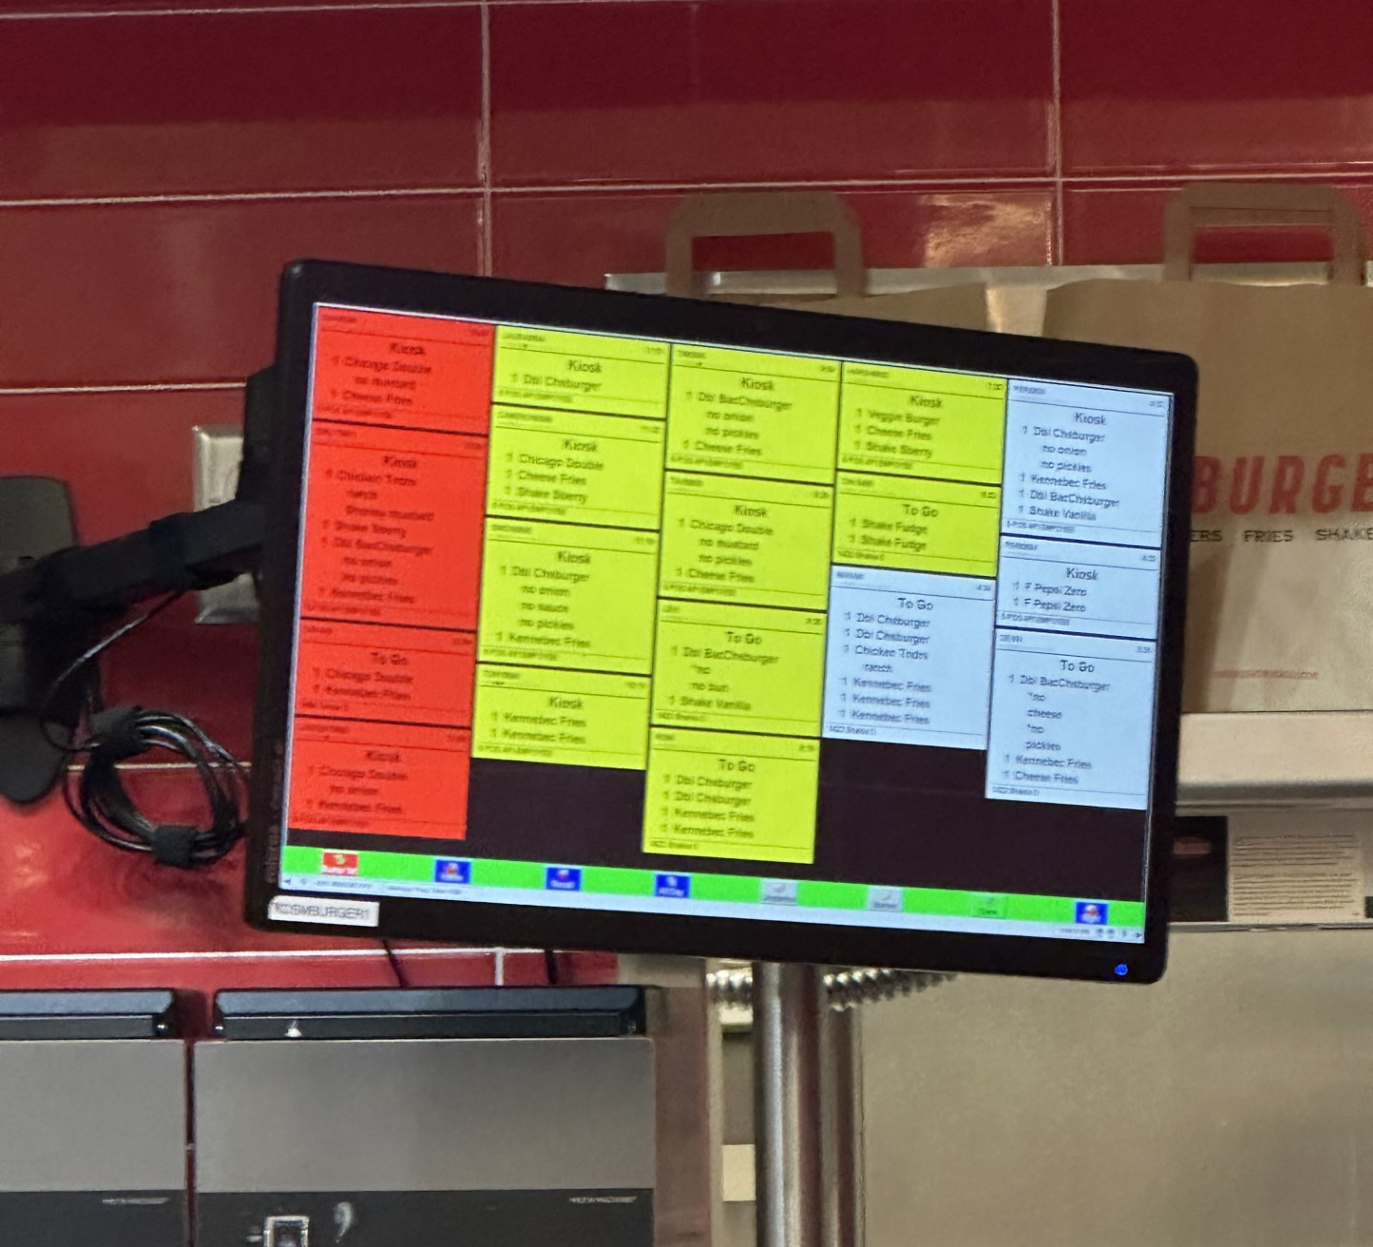
Nonsocial Source: An Example

Slide 22

Performance Reviews

Slide 23
Giving Performance Feedback
Scheduling
Scheduling performance feedback
Should be a regular, expected activity
Once a year is not enough
Feedback is most effective when it does not surprise the employee
Preparing
Preparing for a feedback session
Location should be neutral
Should be described as a chance to have an open dialogue about the role of the employee, the role of the manager, and the relationship between them
Enable the employee to be well-prepared

Slide 24
Conducting the Feedback Session
Tell-and-sell approach
Managers tell the employees their ratings and then justify them
Tell-and-listen approach
Managers tell employees their ratings and then let the employees explain their side of the story
Problem-solving approach
Managers and employees work together to solve performance problems in an atmosphere of respect and encouragement

Slide 25

Performance Management: Best Practices
Managers must clearly and consistently communicate the standards they expect employees to meet
To engage in effective feedback, managers should:
Engage in active listening
Clearly address issues
Build employees’ esteem

Slide 26
Let’s Practice!
You will be assigned to a manager or employee role
Read the provided information about your role then discuss with a partner in the same role for 5 minutes about a good approach
Engage in a performance review conversation with someone of the opposite role (10 minutes)
We will debrief as a class

Slide 27

Debrief Questions
How did you prepare for the performance conversation meeting?
Was your approach effective—why or why not?
What was your desired outcome? Did you achieve it?
What worked well? What did not work so well?

